Slide 1
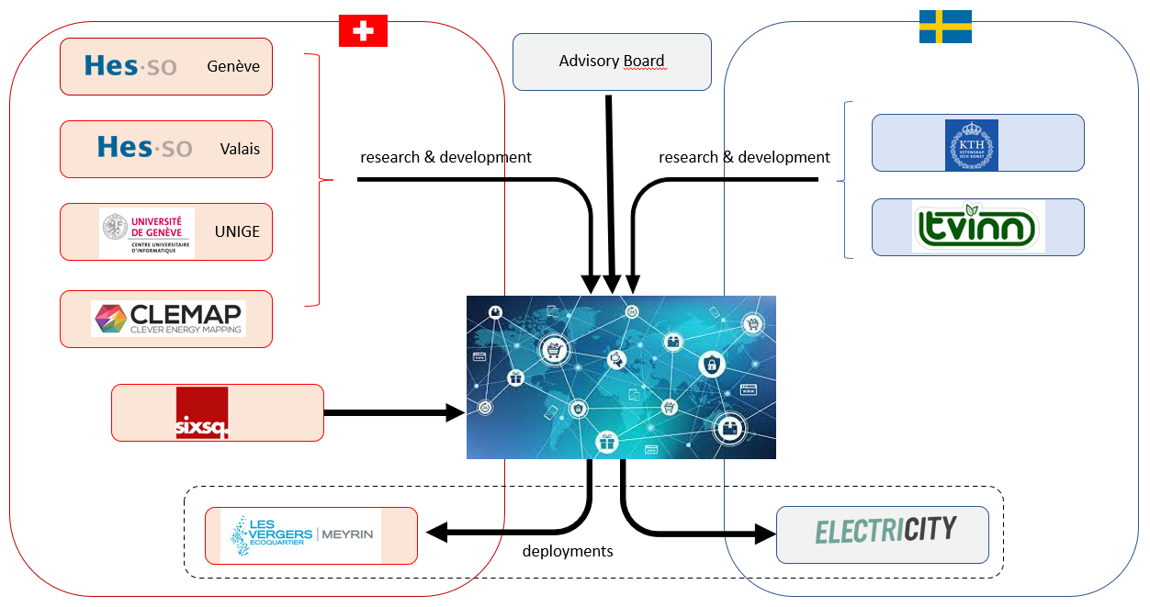
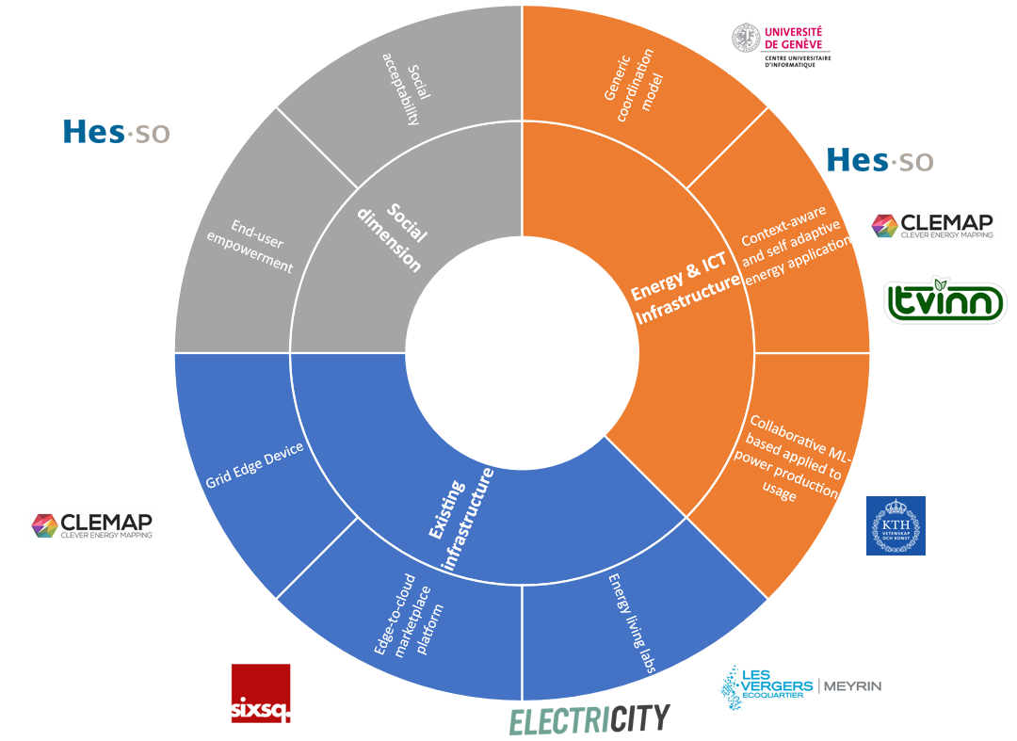
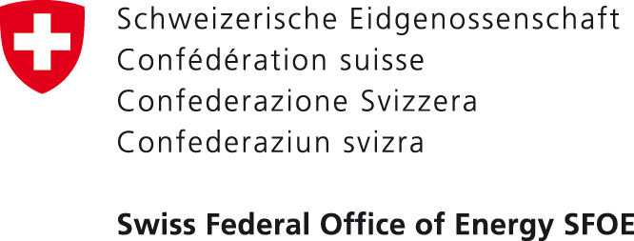

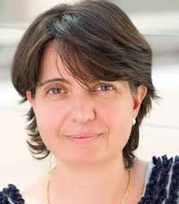
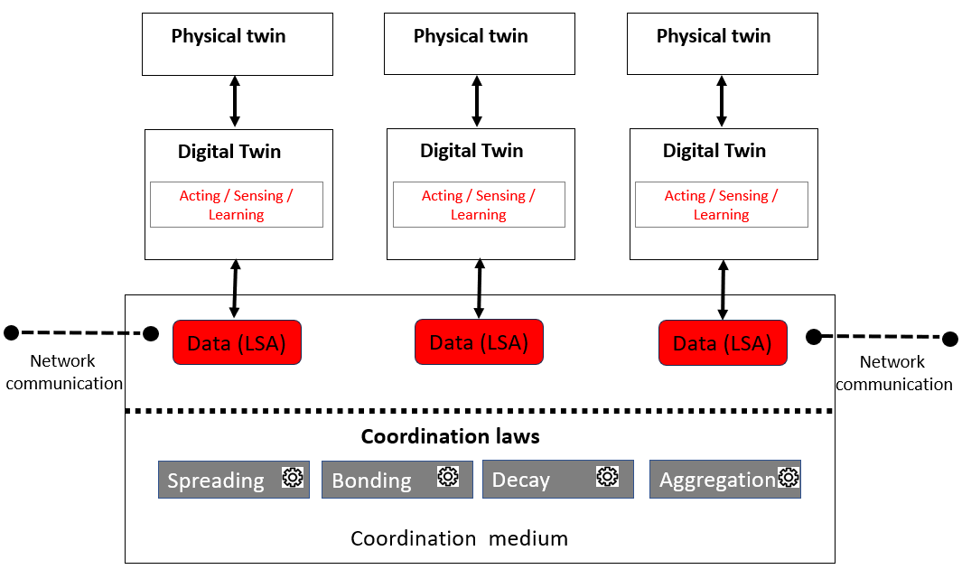
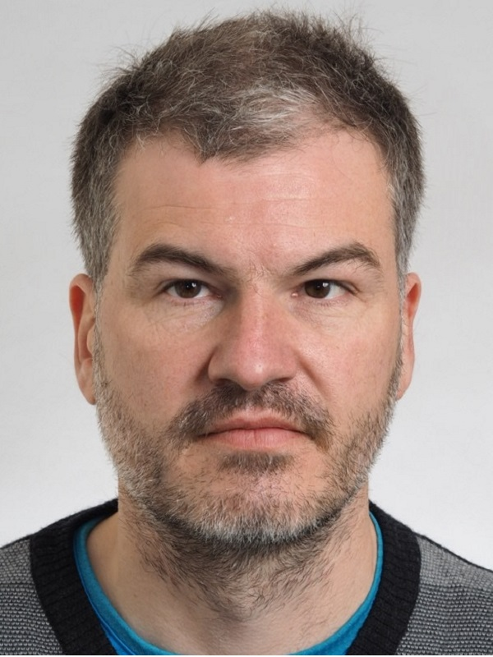
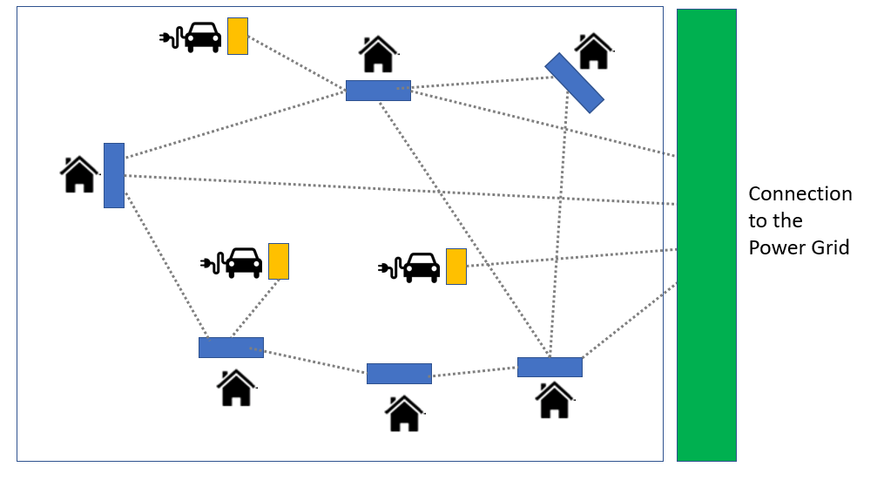
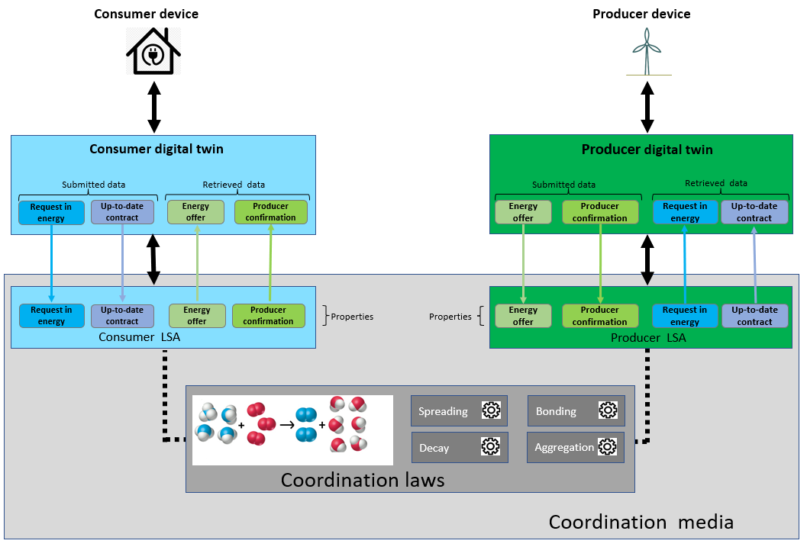
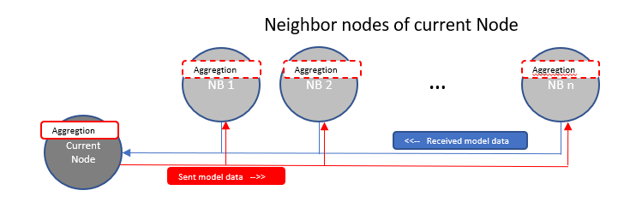
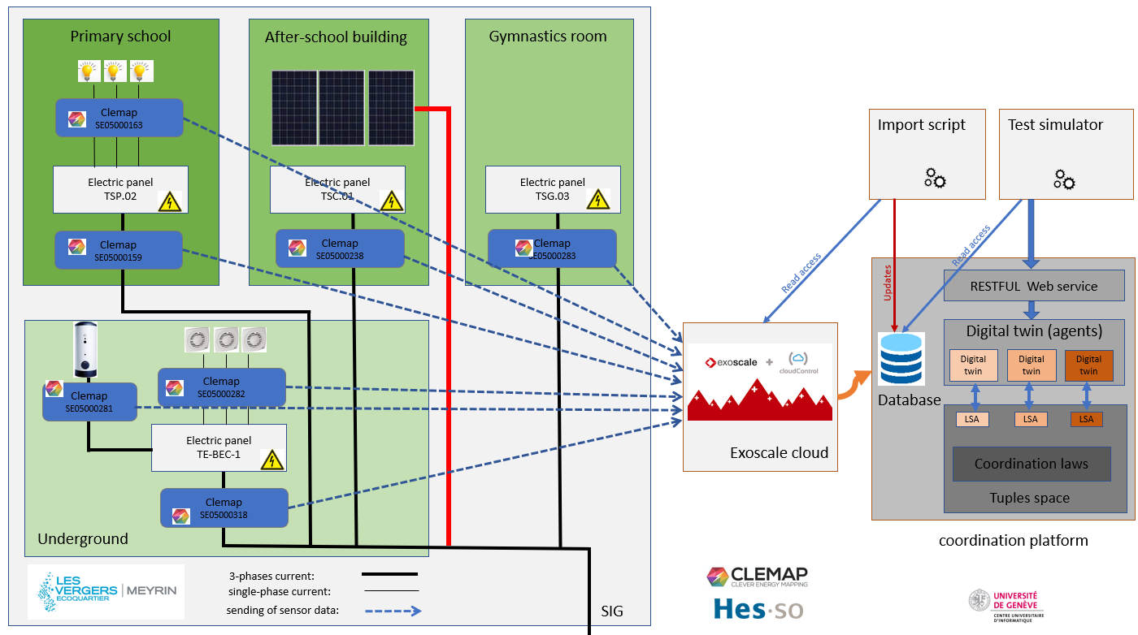
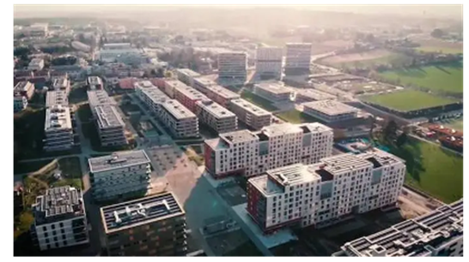

Coordination model and digital twins for managing energy consumption and production in a smart grid
Team
Method
Lasagne project (2022-2025)
Main axes of Lasagne project:
physical/network infrastructure
IT: AI & algorithm
social dimension
UNIGE Team:
Prof. Giovanna Di Marzo Serugendo is full professor at Geneva School of Social Sciences, and the Computer Science Center of the University of Geneva, Switzerland.
Implement a coordination platform enabling digital twins to interact asynchronously.
Philippe Glass is PhD student and research assistant at UNIGE, He has a MSC in AI (University of Lyon, France) and in computer science (ENSEEIHT, Toulouse, France).
Research experience in AI (UNIGE):
Design of a smart grid model at household level (Internship)
Pre-study of a ML project for catering
Implementation of a feed stream for the RDF knowledge base to detect anomalies in water, gas and heating networks.
Implement energy agents (twins) and algorithms for coordinating GEDs activities.
Motivation
Implement a digital framework for “Gossip” federated learning among GEDs networks.
Problem
Smart meters, which we call Grid Edge Devices (GED), do not yet manage energy exchanges in a collaborative and decentralized way. Issues to consider:
At a local level, consumption and production devices cannot negotiate and exchange energy independently.
It is difficult to manage renewable energy whose production is particularly fluctuating.
current smart grids do not consider the social dimension. The integration of social criterion would help to reinforce user confidence and involvement.
Research Questions
Can we design a coordination model and mechanisms that allows Grid Edge Devices to collectively achieve various objectives?
How can we model the notion of digital twins to represent micro-grid entities which exchange and regulate energy at a local level?
How can we integrate into the coordination model a mechanism of Gossip based Federated learning, with an aggregator that the level service can define on the fly?
In what extends can we integrate criteria of social acceptability into Digital Twins behaviours, in decision-making process for electricity transaction and electricity regulation?
Solution: self-organization and self-adaptation
Use MAS and coordination models to enhance GED capacities: interaction, self-adaptation, algorithms to manage rate negotiation, power transactions, grid stability.
Using the coordination model to introduce “gossip” federated and distributed learning.
Consider social acceptability criteria in the algorithm that take decisions, to facilitate the acceptance of micro-grid applications.
Data collection from the living lab “Les Vergers” (use of CLEMAP smart meters),
Roadmap
Deployment of the existing solution on CLEMAP devices.
Integration of the Gossip Learning mechanism into the coordination platform.
Staggering of demand over time when energy availability is not sufficient.
Integration of social acceptance by design.
Integration of negotiation between digital twins (peer-to-peer or using an organization such as an auction).
Modeling of prosumer digital twin.
Publications on MDPI, IEEE.
Publications
P. Glass and G. Di Marzo Serugendo, Plateforme de coordination et collaboration pour échanger l’énergie, réguler et prédire la production/consommation dans le cadre d’un réseau électrique intelligent, University of Geneva, Geneva, Switzerland, Tech. Rep., 2021.https://archive-ouverte.unige.ch/unige:155369
P. Glass and G. Di Marzo Serugendo : Poster presented at the Data Science Day on September 15, 2022 https://archive-ouverte.unige.ch/unige:164521
E. Fragniere, S. Sandoz, N. Abdenadher, M. Moussa, G. Di Marzo Serugendo and P. Glass Improving the Social Acceptability of Microgrids https://ieeexplore.ieee.org/document/10236324
CENTRE UNIVERSITAIRE D’INFORMATIQUE

